Slide 1
HealthAI Assistant: A Smart Web Platform for Symptom Analysis and Doctor Consultations
Sruthi Basineni - 1RVU22BSC013
Subhashini N - 1RVU22BSC061

Slide 2
Introduction:
Accessing healthcare is still difficult for many people, especially after the COVID-19 pandemic. Patients often have to wait for a long time or travel long distances just to meet a doctor. This project solves that problem by offering a simple and easy-to-use online health platform. It allows patients to check their symptoms, book appointments, and save their health records—all from the comfort of their home.

Slide 3
Problem Statement:
Hard to find verified doctors, especially in rural areas
Long waiting times in clinics and hospitals
No easy way to check symptoms or track health history
Need for a centralized platform to manage appointments and consultations

Slide 4
Proposed Solution:
HealthAI Assistant provides:
AI-powered symptom checker
Verified Indian doctor profiles and online booking
Digital storage of patient health records
Different dashboards for Patients, Doctors, and Admins
Easy, secure access from computer or mobile

Slide 5
Technology Stack:
Frontend:
React.js, TypeScript, Tailwind CSS, Shadcn UI
Backend & Database:
Supabase (auth, database, APIs)
PostgreSQL for storing appointments and health data

Slide 6
Main Features:
Login & Sign-up (Role-based: Patient, Doctor, Admin)
Symptom Checker (AI-based suggestions)
Doctor Profiles & Booking
Digital Health Records
Dashboards:
1.Patients see history & health tips
2.Doctors manage appointments
3.Admin sees system overview

Slide 7
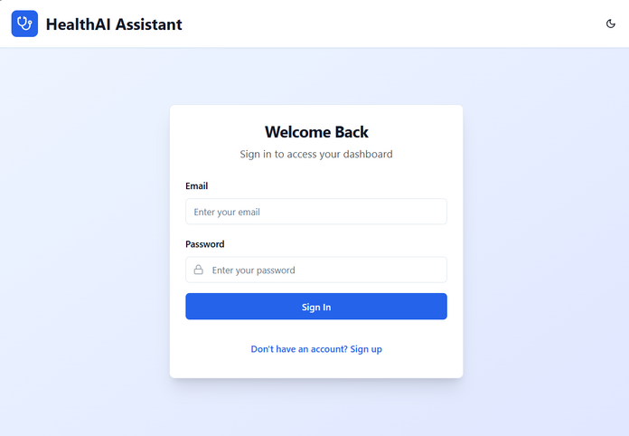
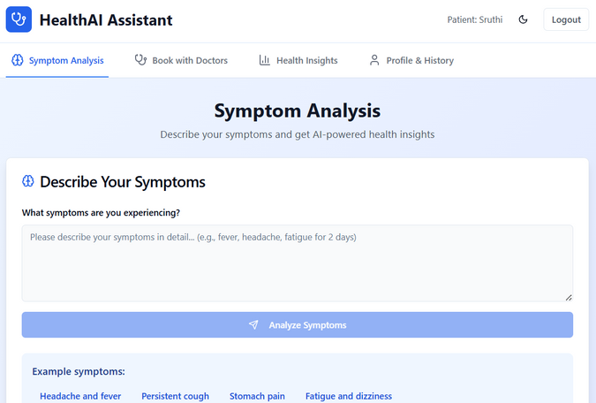
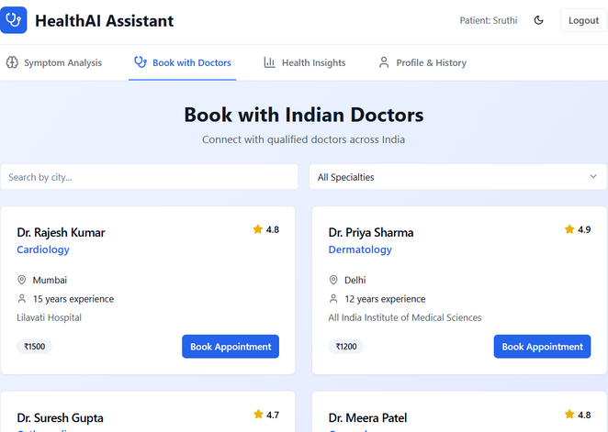
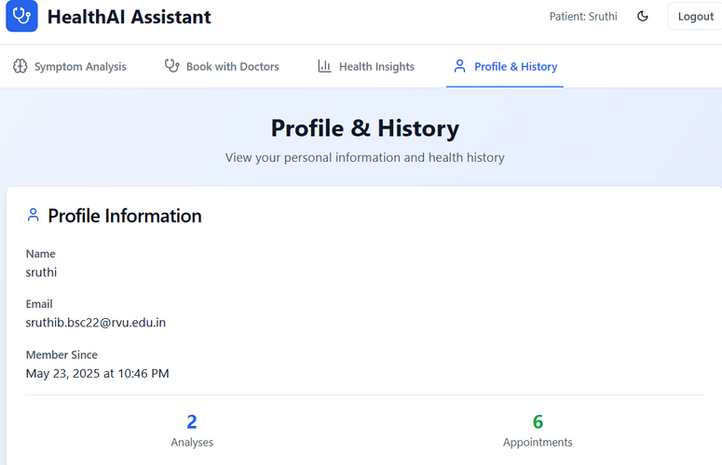
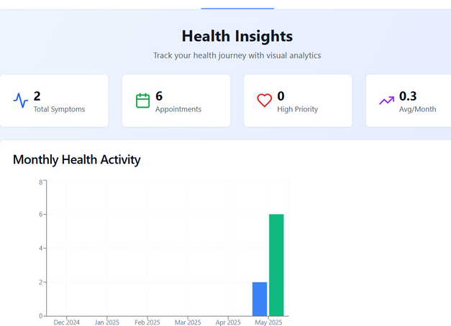
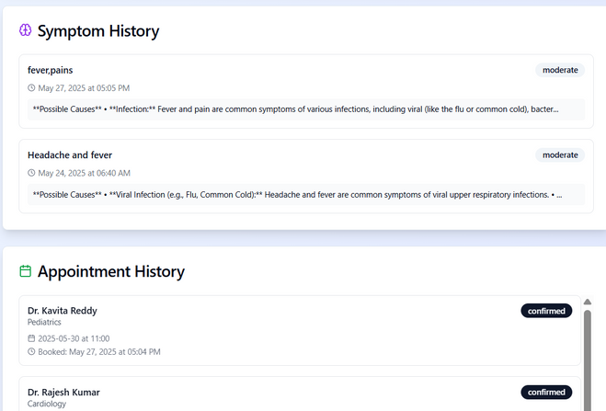

Slide 8
Future Scope:
Video consultations
Prescription uploads
Mobile app version
Health device integration
Multi-language support

Slide 9
Conclusion:
The HealthAI Assistant project shows how technology can make healthcare easier and more helpful for everyone. It lets people check their symptoms, book doctor appointments, and keep their health records online. This saves time and makes things simpler for both patients and doctors. The platform is safe, easy to use, and works well for people in cities as well as in remote areas. In short, this project shows that online tools can help more people get the medical help they need, whenever and wherever they need it.

